Slide 1
Hospital Data Analysis
Overview of patient cases, trends, and department performance
Created by: Shreya Moghe
Guided by: Sumit Patil
Date: 08/10/2024

Slide 2
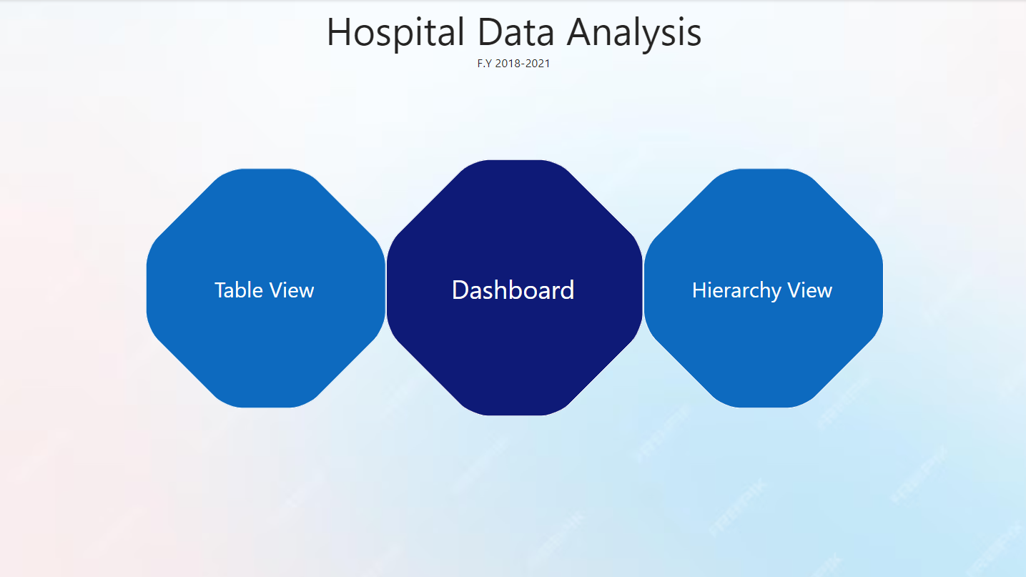

Slide 3
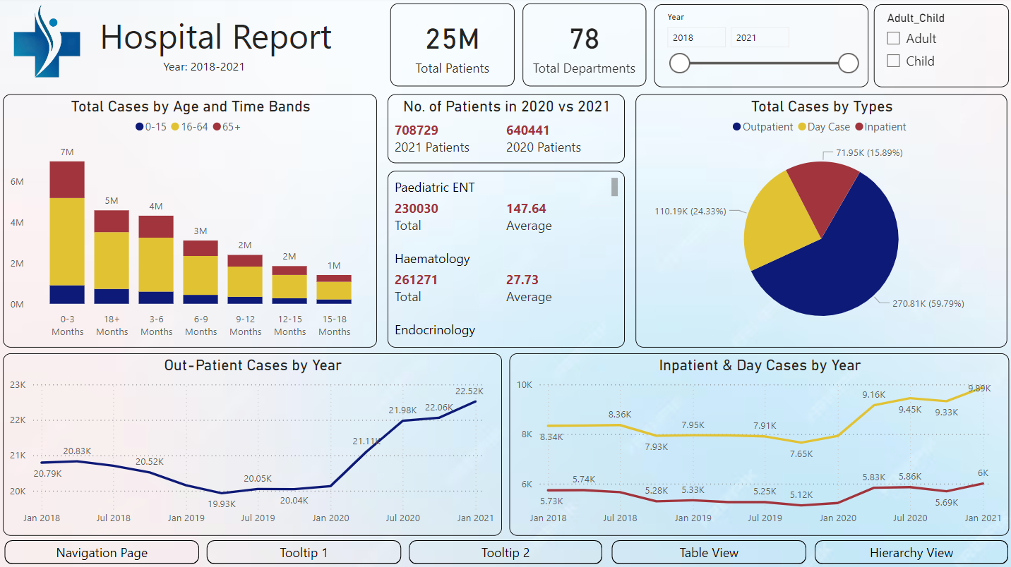
Hospital Report

Slide 4
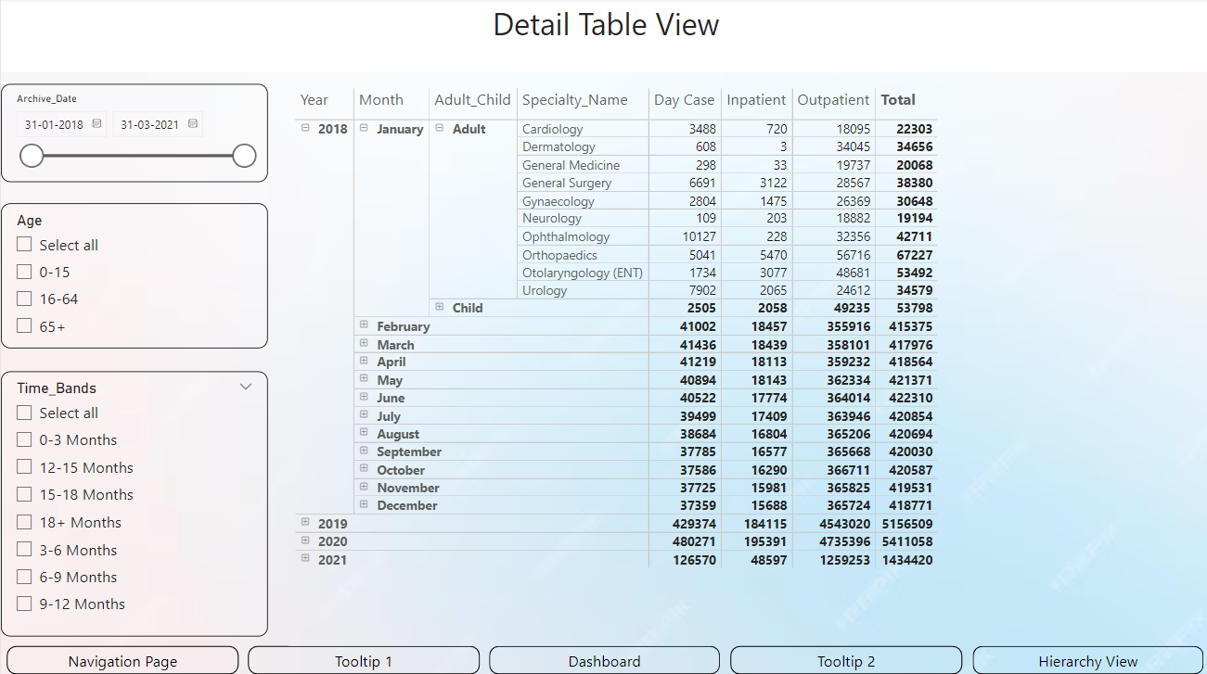
Table View

Slide 5
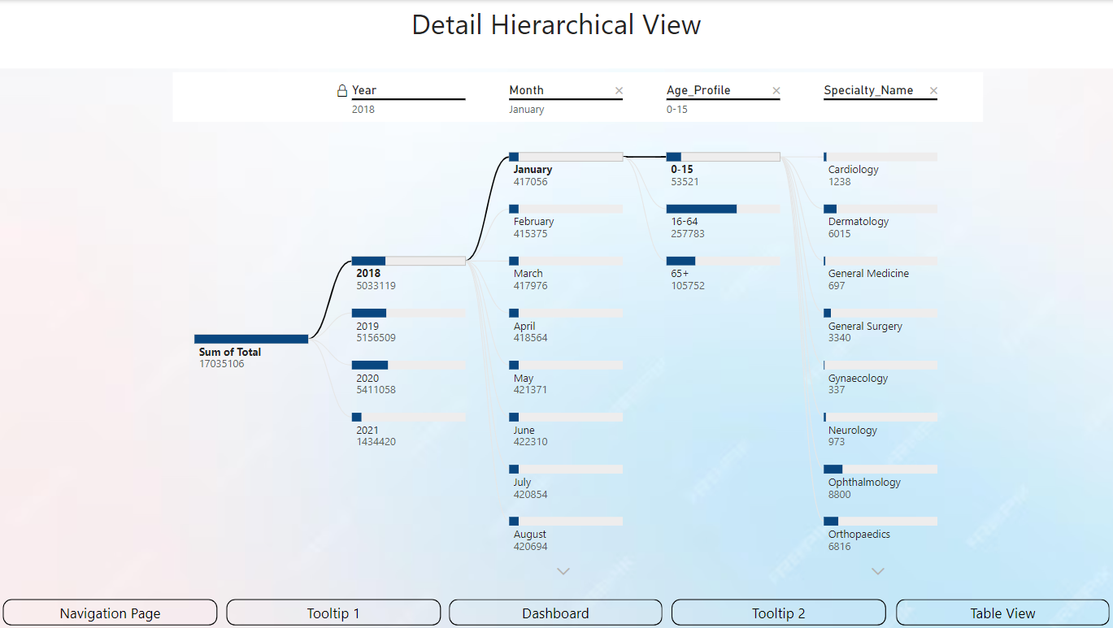
Hierarchy View

Slide 6
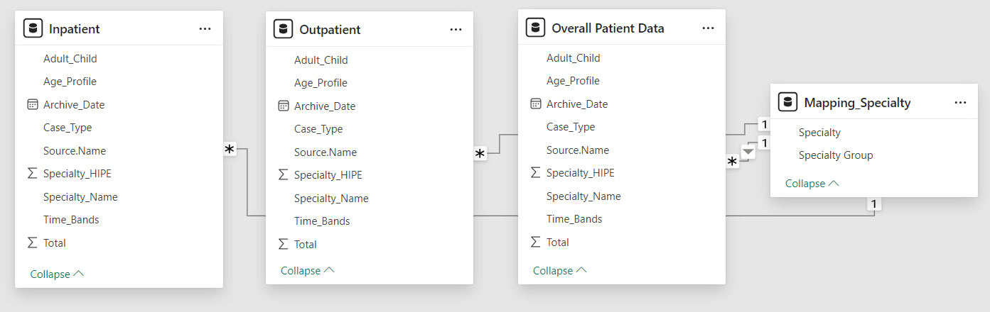
Data Model
The overall patient data is connected to the Mapping_Speciality table via a many-to-one relationship. This ensures that each specialty is accurately linked to multiple patient records, enabling detailed analysis of department-specific performance.

Slide 7
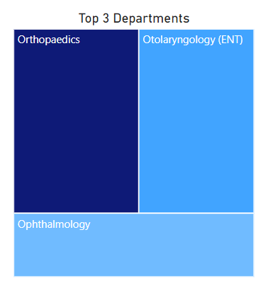
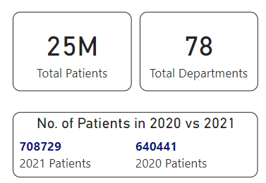
Measures Overview
The dashboard displays key metrics with a total of 25 million patients across 78 departments, with the top three performing departments being Orthopedic, Otolaryngology, and Ophthalmology.

Slide 8
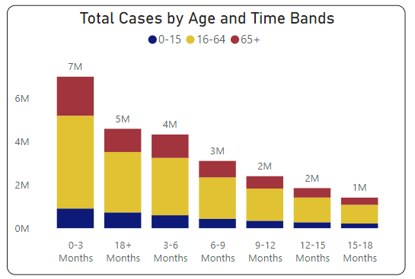
Total Cases by Age Group - I
The bar chart shows the distribution of total cases across time bands, which represent when patients are called back for check-ups. The highest number of cases occurs within the 0-3 months time band, with most patients falling in the 16-64 age group. The number of cases decreases as the time between check-ups increases.

Slide 9
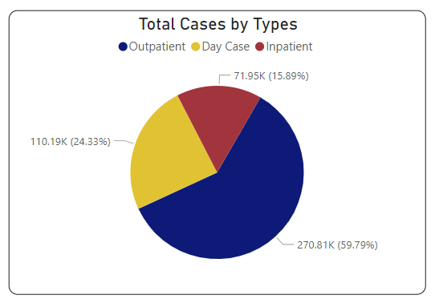
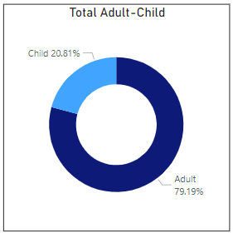
Total Cases by Age Group - II
Outpatients are patients who visit the hospital for consultations and leave the same day, representing the largest portion at 59.79%.
Inpatients stay for treatment, accounting for 15.89%
Day Case patients are admitted for less than 24 hours, making up 24.33% of total cases.
The tooltip offers a detailed age group breakdown, indicating the number of adult and child patients.

Slide 10
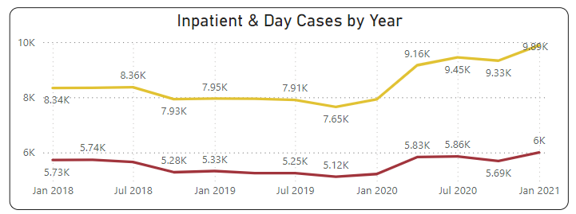
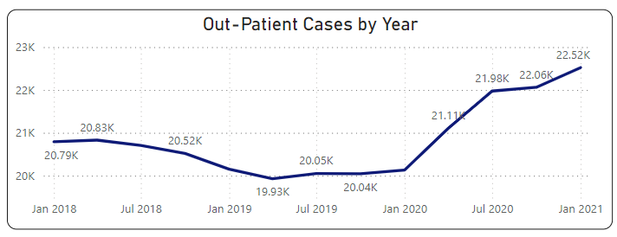
Yearly Comparison of Patients

Slide 11
Key Insights
Age and Time Bands: Most cases fall within 0-3 months, with the majority being aged 16-64.
Outpatient Dominance: Outpatients represent 60% of cases, followed by day cases (24%) and inpatients (16%).
2020 vs 2021 Comparison: A notable decrease in patient numbers, likely due to pandemic factors.
Departmental Highlights: Key departments, such as Pediatric ENT and Hematology, maintained consistent demand.

Slide 12
Recommendations
Prioritize Early Follow-ups: Given the high patient load within 0-3 months.
Optimize Outpatient Services: Outpatients make up the majority of hospital cases.
Monitor High-Volume Departments: Continue supporting critical departments like Pediatric ENT and Hematology.

Slide 13
Thank you!!

